Slide 2
4.1 Additional Operators
Extended Assignment Operators
The assignment operator can be combined with the arithmetic and concatenation operators to provide extended assignment operators. For example
int a = 17;
String s = “hi”;
a += 3; // Equivalent to a = a + 3;
a -= 3; // Equivalent to a = a – 3;
a *= 3; // Equivalent to a = a * 3;
a /= 3; // Equivalent to a = a / 3;
a %= 3; // Equivalent to a = a % 3;
s += “ there”; // Equivalent to s = s + “ there”;

Slide 3
4.1 Additional Operators
Extended assignment operators can have the following format.
variable op= expression;
which is equivalent to
variable = variable op expression;
Note that there is no space between op and =.
The extended assignment operators and the standard assignment have the same precedence.

Slide 4
4.1 Additional Operators
Increment and Decrement
Java includes increment (++) and decrement (--) operators that increase or decrease a variables value by one:
int m = 7;
double x = 6.4;
m++; // Equivalent to m = m + 1;
x--; // Equivalent to x = x – 1.0;
The precedence of the increment and decrement operators is the same as unary plus, unary minus, and cast.

Slide 5
Standard Classes and Methods
The Math Class
Notice that two methods in the table are called abs. They are distinguished from each other by the fact that one takes an integer and the other takes a double parameter.
Using the same name for two different methods is called overloading

Slide 6
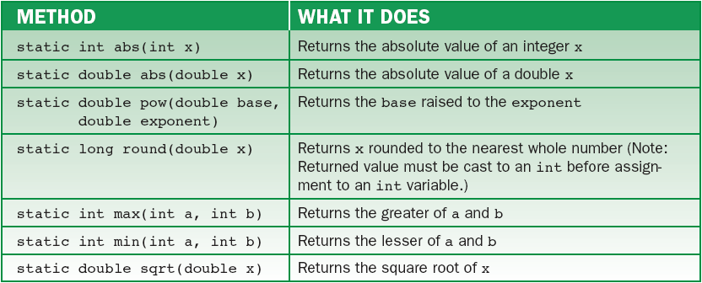
4.2 Standard Classes and Methods
Seven of the methods in the Math Class

Slide 7
abs() and Method Overloading
The two abs() methods are overloaded.
Overloaded: Multiple methods in the same class with the same name
Using sqrt() method example:

Slide 8
Standard Classes and Methods
The sqrt Method
This code segment illustrates the use of the sqrt method:
// Given the area of a circle, compute its radius
// Use the formula a = πr² , where a is the area and
// r is the radius
double area = 10.0, radius;
radius = Math.sqrt (area / Math.PI);
Messages are usually sent to objects; however, if a method’s signature is labeled static, the message instead is sent to the method’s class.

Slide 9
Standard Classes and Methods
The sqrt Method
Thus, to invoke the sqrt method, we send the sqrt message to the Math class.
In addition to methods, the Math class includes good approximations to several important constants.
Math.PI is an approximation for π accurate to about 17 decimal places.

Slide 10
Math class methods examples

Slide 11
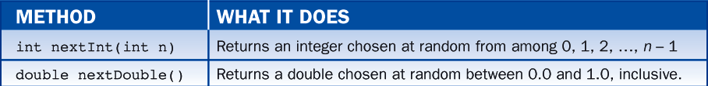
Standard Classes and Methods
The Random Class
A random number generator returns numbers chosen at random from a predesignated interval.
Java’s random number generator is implemented in the Random class and utilizes the methods nextInt and nextDouble as described in table 4-2.
A program that uses the Random class first must import java.util.Random.

Slide 12
Random Class Example
import java.util.Scanner;
import java.util.Random;
//Generate an integer between 0 and user’s upper limit
Scanner reader = new Scanner(System.in);
Random generator = new Random ();
System.out.print(“Enter the upper limit for a random int: ");
upperLimit = reader.nextInt();
System.out.print(generator.nextInt(upperLimit ));

Slide 13
Math.random()
The College Board tests on Math.random() instead of importing the Random class and using nextInt(), etc.
Math.Random generates a decimal within the range: 0.0 <= random <1.0
To generate integers, use this formula:
randomInt= (int) (Math.random()*(HIGH - LOW + 1))+ LOW;
Where HIGH & LOW are constants representing the largest and smallest integers you wish to have generated.

